Slide 1
Semantic kernel
https://learn.microsoft.com/en-us/semantic-kernel/overview

Slide 2
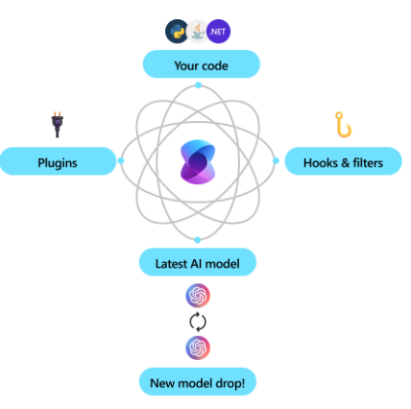
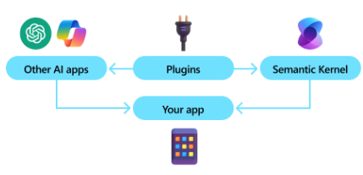
What is Semantic kernel?
Lightweight, open-source development kit
Build AI agents
Integrate the latest AI models

Slide 3
Some useful settings in csproj
<UnoSingleProject>true</UnoSingleProject>
<HotReloadEnabled>true</HotReloadEnabled>
<IsHotReloadSupported>true</IsHotReloadSupported>
<UseSkia>true</UseSkia>

Slide 4
Add Nuget package
$ dotnet add package Microsoft.SemanticKernel
using Microsoft.SemanticKernel.ChatCompletion;
using Microsoft.SemanticKernel.Connectors.OpenAI;
OpenAIChatCompletionService chatCompletionService;

Slide 5
Init
public MainPage() {
#pragma warning disable SKEXP0010
chatCompletionService = new (
modelId: "deepseek-r1-distill-qwen-7b:2",
endpoint: new Uri("http://localhost:1234/v1"),
httpClient: new HttpClient()
);
}

Slide 6
Making the call
var response = await chatCompletionService.GetChatMessageContentAsync(
prompt
);
answerTextBlock.Text = response.Content;

Slide 7
LM Studio to serve local chat service
Model: deepseek-r1-distill-qwen-7b

